Slide 1
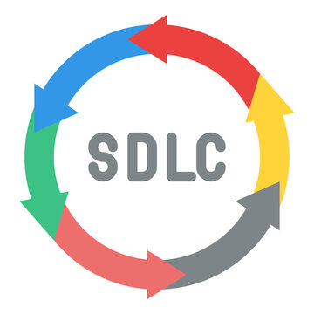
Software Development Life Cycle (SDLC)
By - Shubham Tiwari

Slide 2
Introduction
Software development life cycle (SDLC) is a structured process that is used to design, develop, and test good-quality software.
A software life cycle model describes entry and exit criteria for each phase. A phase can begin only if its stage-entry criteria have been fulfilled. So without a software life cycle model, the entry and exit criteria for a stage cannot be recognized.
The goal of the SDLC life cycle model is to deliver high-quality, maintainable software that meets the user’s requirements.

Slide 3
Need of SDLC
Structured Approach: SDLC provides a structured framework for software development, ensuring systematic planning, execution, and delivery of high-quality software products.
Clarity and Transparency: SDLC promotes clear communication and transparency among stakeholders by defining project objectives, requirements, and deliverables at each phase.
Resource Optimization: SDLC optimizes resource allocation by aligning tasks and activities with project timelines, reducing inefficiencies and maximizing productivity.

Slide 4
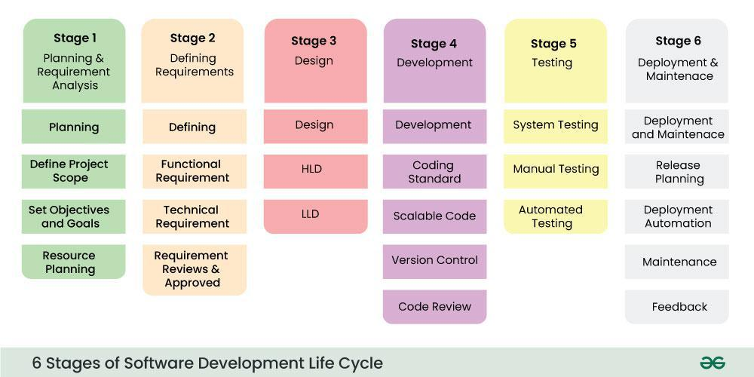

Slide 5
Phase 1- Planning and Requirement Analysis
The planning phase typically includes tasks like cost-benefit analysis, scheduling, resource estimation, and allocation.
Requirement Analysis is crucial in SDLC, led by senior team members with inputs from stakeholders and domain experts.
Business analysts and project organizers convene meetings with clients to gather essential data, including project objectives and end-user needs.

Slide 6
Phase 2 - Requirements Gathering
In this stage, all the requirements for the target software are specified. These requirements get approval from customers, market analysts, and stakeholders.
This is accomplished through "SRS"- Software Requirement Specification document which contains all the product requirements to be constructed and developed during the project life cycle.
This is a sort of document that specifies all those things that need to be defined and created during the entire project cycle.

Slide 7
Phase 3 - Designing Architecture
The next phase is about to bring down all the knowledge of requirements, analysis, and design of the software project. This phase is the product of the last two, like inputs from the customer and requirement gathering.
In the Design phase, we translate the gathered requirements into a technical blueprint for the software solution.
Hence, with the requirements defined in SRS, multiple designs for the product architecture are present in the Design Document Specification (DDS).

Slide 8
Phase 4 - Implementation
In this phase of SDLC, the actual development begins, and the programming is built.
The implementation of design begins concerning writing code. Developers have to follow the coding guidelines described by their management and programming tools like compilers, interpreters, debuggers, etc. are used to develop and implement the code.
Some popular languages like C/C++, Python, Java, etc. are put into use as per the software regulations.

Slide 9
Phase 5 - Testing
After the development of the product, testing of the software is necessary to ensure its smooth execution. Although, minimal testing is conducted at every stage of SDLC.
Therefore, at this stage, all the probable flaws are tracked, fixed, and retested. This ensures that the product confronts the quality requirements of SRS.
During this stage, unit testing, integration testing, system testing, acceptance testing are done.

Slide 10
Phase 6 - Deployment
After detailed testing, the conclusive product is released in phases as per the organization’s strategy.
Once the software is certified, and no bugs or errors are stated, then it is deployed.
Then based on the assessment, the software may be released as it is or with suggested enhancement in the object segment.

Slide 11
Phase 7 - Maintenance
After the software is deployed, then its maintenance begins.
Once when the client starts using the developed systems, then the real issues come up and requirements to be solved from time to time.
Provide assistance to users and address their issues promptly.
Iteratively enhance the software based on user feedback and changing requirements.

Slide 12
THANK YOU

